Slide 1

Soccer Player Performance Analysis
SUPARNA
MB30

Slide 2
Problem Statement
Analyze soccer player performance data to uncover insights into player skills, trends, and team comparisons.
Tools used:
✔ Excel – Data cleaning & preprocessing ✔ Power BI – Data visualization

Slide 3
⚽ How Soccer Player Analysis Helps?
Find the Best Players – Identify top talent for recruitment.
Improve Performance – Analyze skills to build strong teams.
Prevent Injuries – Track fitness to avoid injuries.
Engage Fans – Use player stats to boost fan excitement.
Negotiate Contracts – Justify salaries with performance data.

Slide 4
⚽ Soccer Player Analysis Using MS Excel
Collect Data – Player stats from available datasets.
Clean & Prepare – Fix missing values and standardize data.
Analyze & Explore – Use Excel for trends & insights.
Create Metrics – Build new measures for better comparisons.
Visualize & Report – Design interactive charts & reports.
Key Outcomes
Player Insights – Understand skills & performance.
Scouting Recommendations – Identify top talents.
Business Reports – Highlight key findings.
Interactive Dashboards – Excel-based player stats.
Excel Mastery – Advanced analysis & visualization.

Slide 5
Soccer player analysis using my sql
Objective:
Extract insights from player stats like
Key Areas of Analysis:
Player Performance: Goals, assists,
Player Comparison: Stats across
Team Impact: How players
Trends & Patterns: Player
Injury Analysis: Effect of injuries on
Why Use MySQL?
Stores and manages large soccer datasets efficiently.
Performs complex queries to extract key insights.
Supports joins and aggregations for multi-table analysis.
Helps in player scouting, team management, and strategy.
Analyze soccer players' performance
using MySQL.
goals, assists, passes, and tackles.
passing accuracy, tackles.
different teams, leagues, and seasons
contribute to their team's success.
consistency, form, and improvement.
performance.

Slide 6
Identify the Top Players by Overall Rating

Slide 7
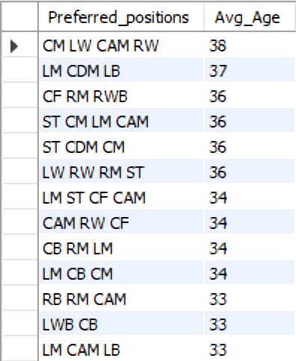
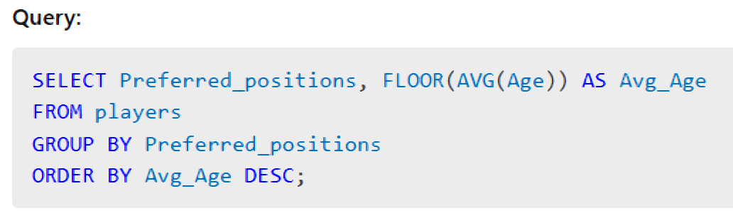
Calculate the Average Age of Players in Each Position

Slide 8
Determine the Market Value Distribution Among Different Nationalities

Slide 9
Analyze Performance Metrics of Players by Club

Slide 10
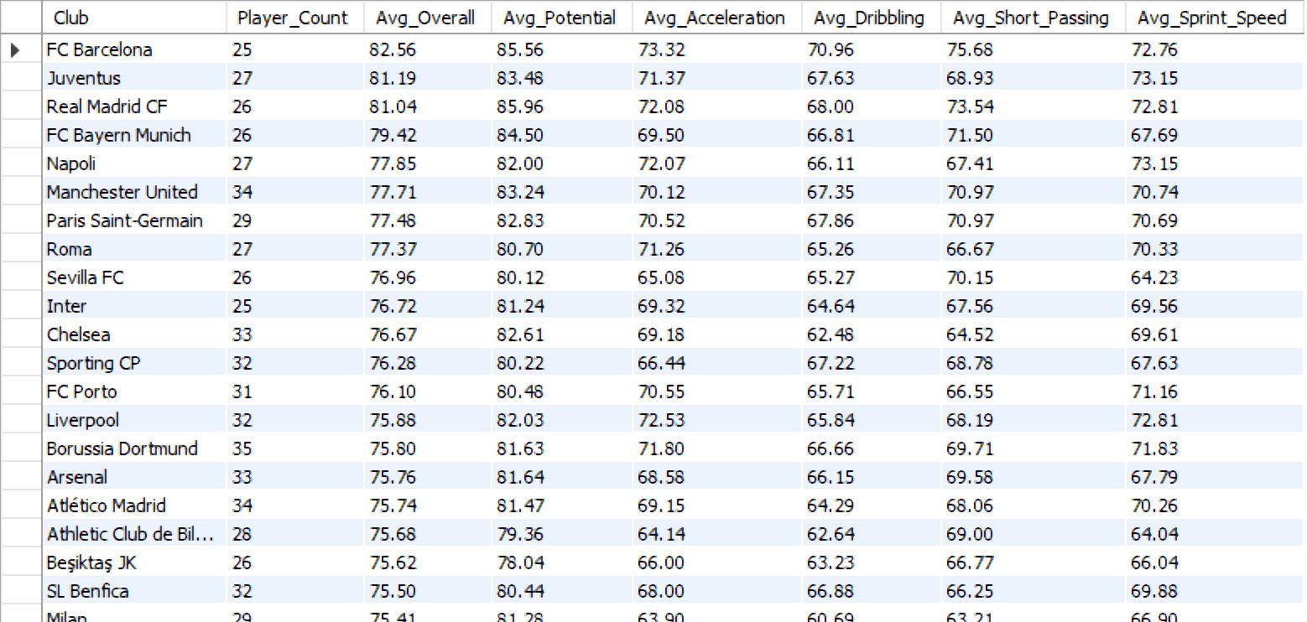
Find the Most Common Positions Played by Top-Performing Players

Slide 11
Find the Most Common Positions Played by Top-Performing Players

Slide 12
Identify Players with the Highest Acceleration and Agility Ratings

Slide 13
Calculate the Average Wage for Players in Each League

Slide 14
Discover Trends in Player Performance Over the Last Few Seasons

Slide 15
Determine the Potential vs. Overall Rating for Young Talents

Slide 16
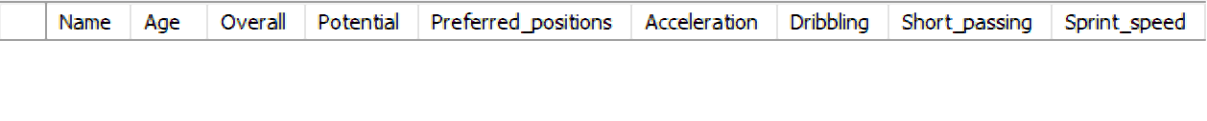
Identify Players with Multiple Preferred Positions and Their Performance Metrics

Slide 17
Analyze Correlations Between Physical Attributes and Skill Ratings

Slide 18
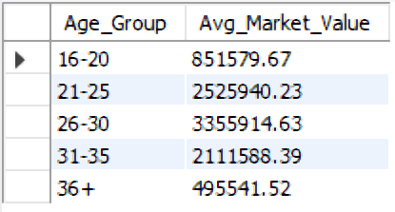
Calculate the Average Market Value of Players by Age Group

Slide 19
Identify Players with the Best Free-Kick Accuracy

Slide 20
Identify Players at Risk of Being Transferred Based on Performance

Slide 21
Power BI Analysis & Insights

Slide 22
Power BI Insights: Visualizing Player Performance & Market Trends
Visualized player statistics using Power BI dashboards.
Market value distribution by nationality and age groups using bar charts.
Club-wise performance metrics analyzed through interactive visuals.
Player trends over seasons explored using line charts.
Position-based performance comparison using heatmaps and tables.
Identified transfer risks through conditional formatting and KPI indicators.
Dynamic filters & slicers used for deeper insights.

Slide 23
Player performance analysis

Slide 24
Player attributes and skills analysis

Slide 25
Player market and transfer insights

Slide 26
Positional and demographic analysis

Slide 27
Conclusion
Identified top-performing players based on overall rating and potential.
Analyzed market value distribution across different nationalities and age groups.
Compared performance metrics of players by club for better insights.
Evaluated player attributes like acceleration, agility, and free-kick accuracy.
Found common positions played by top players and their performance impact.
Determined players at risk of transfer based on low performance or age.
Discovered trends in player performance over the years.
Future scope: Predictive analytics, machine learning models, and data visualization using Power BI/Tableau for deeper insights.

Slide 28
THANK YOU
Suparna
MB30

